Slide 1


Application multimedia
Image Editor
Ai,
Ganesh,
Venkata Chandra Sekhar,
Rahul
Surya Vara Prasad
1

Slide 2

Introduction
Objective :
Develop a small GIMP-like image editor with basic functions
Dilatation / erosion
Resizing
Lighten / Darken
Panorama / Stitching
Canny Edge Detection
Face Detection
2

Slide 3
Presentation steps
0. Menu
1. Dilatation / Erosion
2. Resizing
3. Lighten / Darken
4. Panorama / Stitching
5
3

Slide 4
User’s menu
1
2
Print the choices
Input conditions case
Run the Desired
Functionalities
3
4
Input 1/2/3/4
User
4

Slide 5
Dilatation / Erosion
What is it ?
Shape based morphology transformation
Input image - Structuring element
Rule to the pixel and neighborhood
Output image - same size
The size and shape of the structuring element affects the output image
Structuring element we used :
1 | 1 | 1
1 | 1 | 1
1 | 1 | 1
0 | 1 | 0
1 | 1 | 1
0 | 1 | 0
1
1
1
1
1
1
1
Rectangle
Cross
Ellipse
5

Slide 6
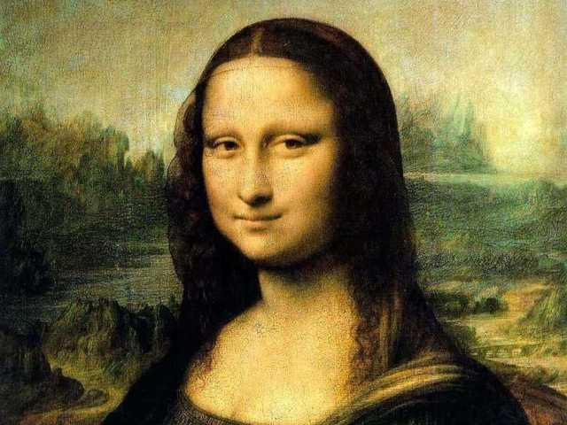
Dilatation / Erosion
Dilatation
Adds pixels to the boundaries of objects in an image
Output pixel = maximum value of the neighborhood pixel’s
Erosion Cross
Erosion
Remove pixels on object boundaries
Output pixel = minimum value of the neighborhood pixel’s
Dilatation Rectangle
6

Slide 7
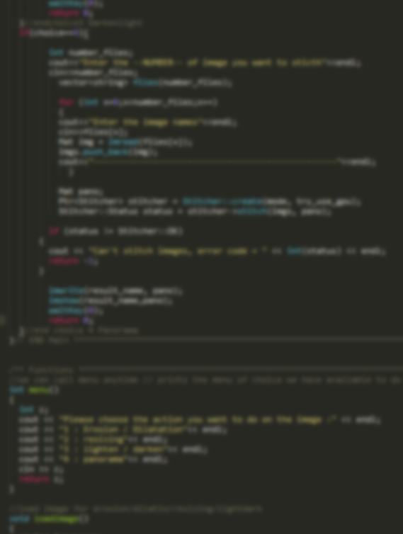
Dilatation / Erosion
In the code
Function
- erode()
- dilate()
Parameters
- Source image
- Output image
- Structuring element
Define the Structuring Element
- Size
- Type
- Create getStructuringElement
7

Slide 8
Resizing
The function resize resizes the image src down to or up to the specified size.
Note that the initial dst type or size are not taken into account.
Instead, the size and type are derived from the src,``dsize``,``fx`` , and fy
. If you want to resize src so that it fits the pre-created dst
, you may call the function as follows:
4

Slide 9
Lighten / Darken
What did we learn:
1.Access pixel value
2.Initialize the matrix with 0
3.saturate_cast
•Pixel transformation
In this type of image processing transformation, the corresponding output pixel values
Are only calculated based on the input pixel values.
This type of operator includes brightness and contrast adjustments, as well as color
Corrections and transformations.
•Brightness and contrast adjustment
1.Two common point processes use constants for multiplication and addition operations
By points:g(x)=αf(x)+β
2. The two parameters \alpha > 0 and \beta are commonly referred to as gain and
offset parameters. We often use these two parameters to control the contrast and brightness
respectively.
3. You can think of f(x) as the source image pixel and g(x) as the output image pixel.
In this way, the above formula can be written more clearly:g(i,j)=α⋅f(i,j)+β
Among them, i and j indicate that the pixel is located in the i-th row and the j-th column.
.
4

Slide 10
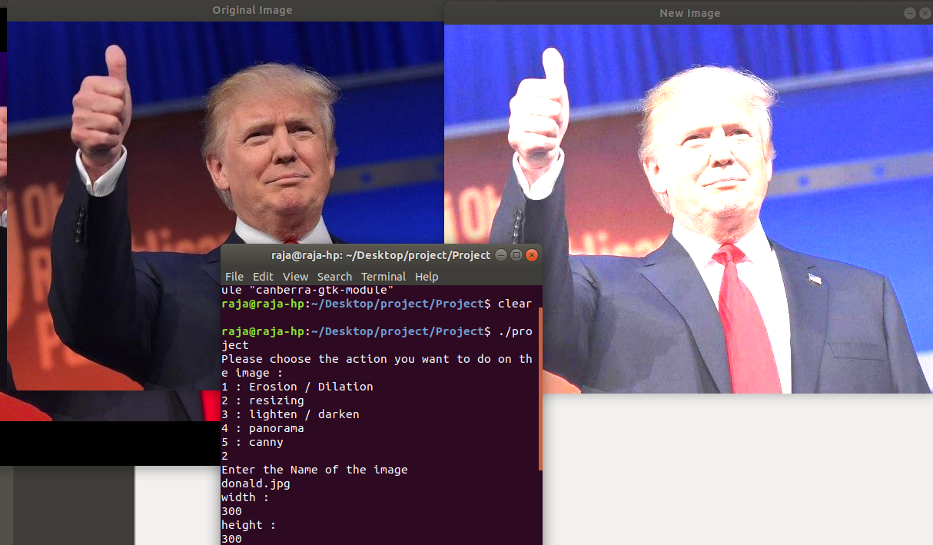

Slide 11
Panorama / Stitching
We use the high-level stitching API for stitching provided bycv::Stitcher
CODE: vector<Mat> imgs;// images to crate panarama
1. Mat pano;
2. Ptr<Stitcher> stitcher = Stitcher::create(mode, try_use_gpu); //create stiches object
3. Stitcher::Status status = stitcher->stitch(imgs, pano);
if (status != Stitcher::OK)
4

Slide 12
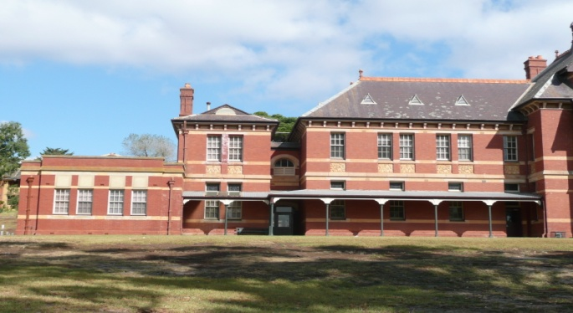
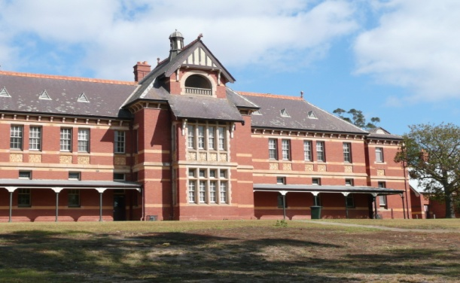
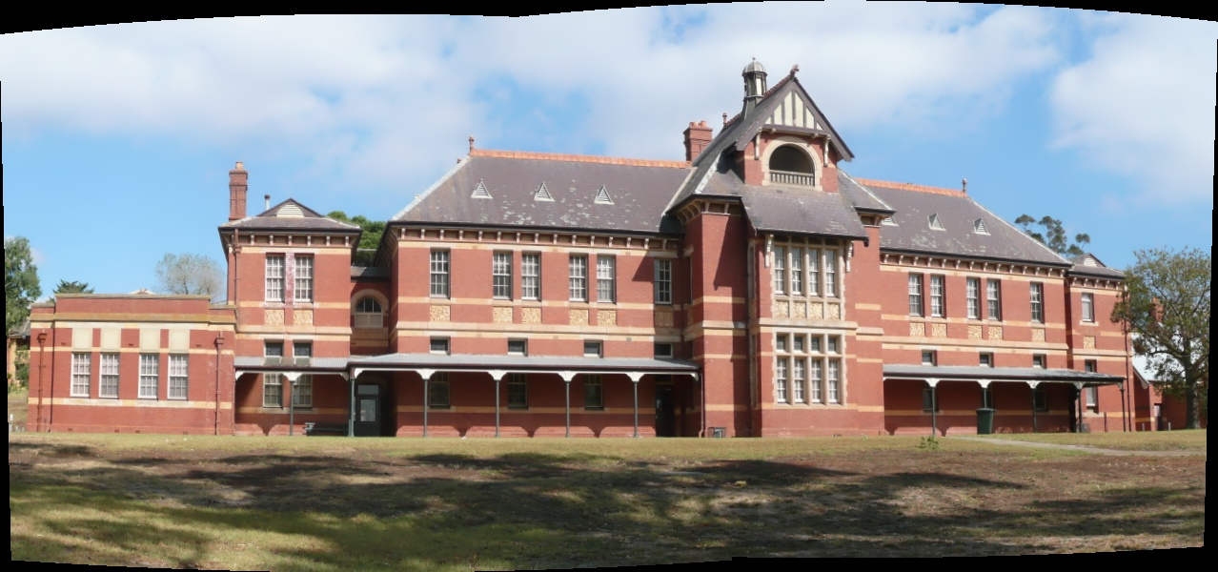
Panorama / Stitching
Image 1
Image 2
Result
4

Slide 13
Canny Edge Detection
Canny Detector and generates a mask (bright lines representing the
edges on a black background).
Applies the mask obtained on the original image and display it in a window

Slide 14
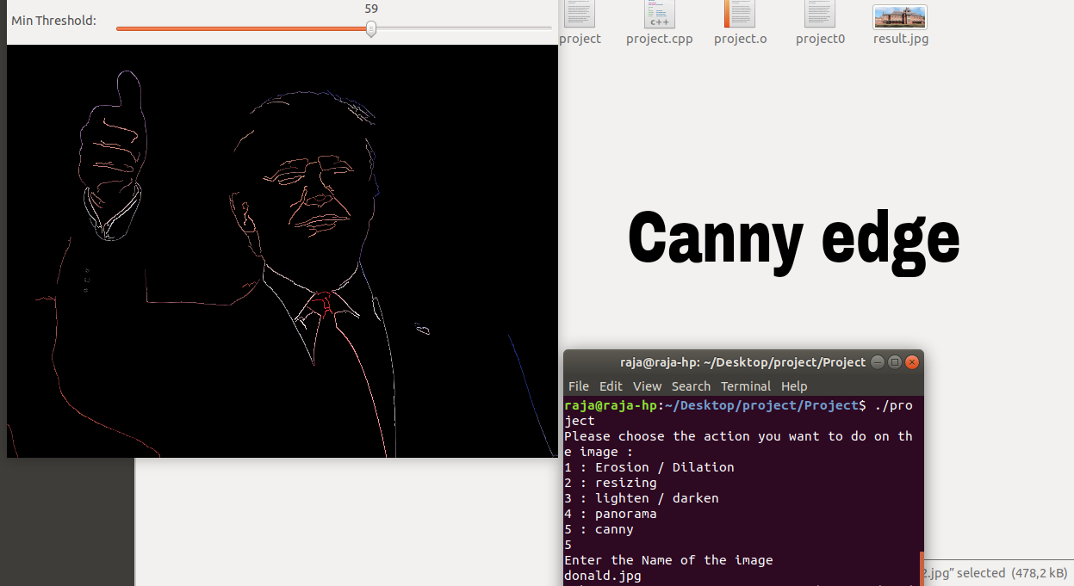

Slide 15
Face Detection
One of the mainstream methods of face detection is class haar+adaboosting, which is
also used in OpenCV.
This method can be extended to the detection of rigid objects, the premise is to train the cascade classifier (for example, with class haar features), once
the training data is completed, directly call opencv class CascadeClassifier, use it a few simple of member functions can complete the detection function.

Slide 16

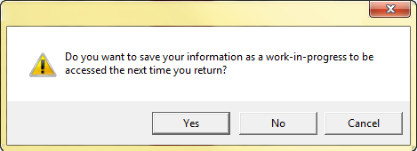

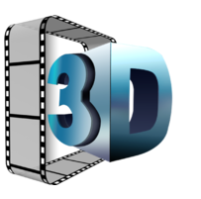
Conclusion
Problems encountered
Demonstration
Saving option
Videos / 3D
4

